Slide 1



Healthcare Clinic Patient Management System
A Comprehensive Database Management Solution
PRESENTED BY:GROUP 4
SIDDHARTH BAHEKAR
RACHITA SHAH
CHITRA PERIYA
VEDANT UKIRDE

Slide 2
AGENDA
Objective
Requirement Gathering
System Requirement
Conceptual Modelling
Logical Modelling
Physical Database Design
Queries
Business Rules
Applications
Challenges
Summary

Slide 3
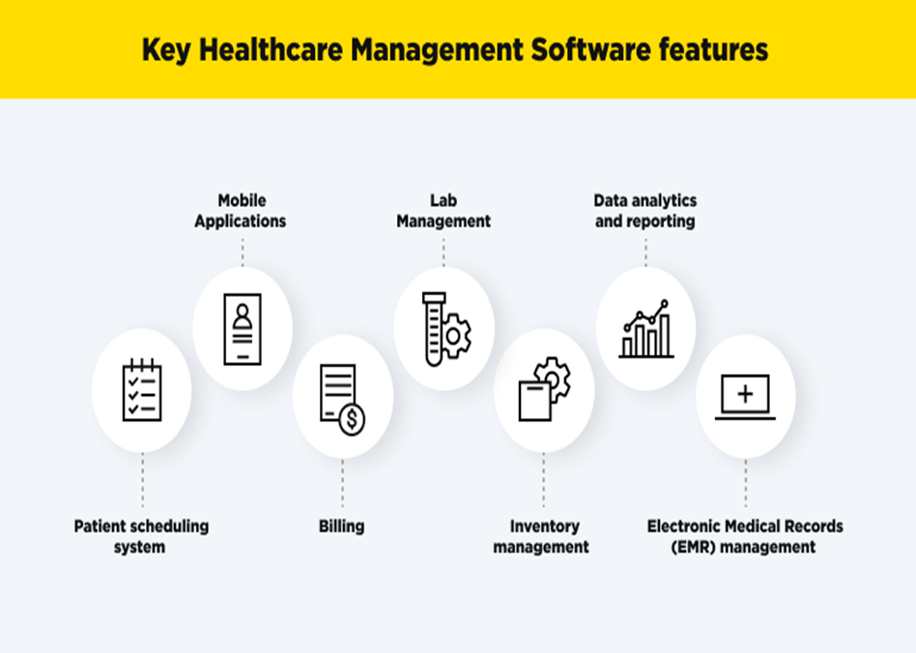

OBJECTIVE
The main objective of the system is:
•Streamline patient care
•Improve operational efficiency
•Enhance data-driven decision-making
Tools & Techniques
Oracle SQL
Draw IO
RDMS & PL/SQL Concepts
React & NodeJS
VisualStudio Code

Slide 4
REQUIREMENT GATHERING
Stakeholder Identification:
Medical Staff (Doctors, Nurses), Administrative Staff, Patients, Laboratory Technicians, Billing Department
Data Collection Methods :
Analysis of existing healthcare systems, Review of medical workflow processes, Study of healthcare regulations and compliance requirements, Evaluation of data security needs
Technical Requirements :
Oracle SQL Database implementation, Data security and privacy compliance, System scalability

Slide 5
SYSTEM REQUIREMENT
Functional Requirement
•User authentication and authorization
•Patient registration and profile management
•Appointment scheduling and management
•Medical records documentation
•Billing and payment processing
•Prescription management
•Laboratory results tracking
Nonfunctional Requirement
•System performance and response time
•Data security and privacy
•System availability
•User interface accessibility
•Data backup and recovery
•System scalability

Slide 6
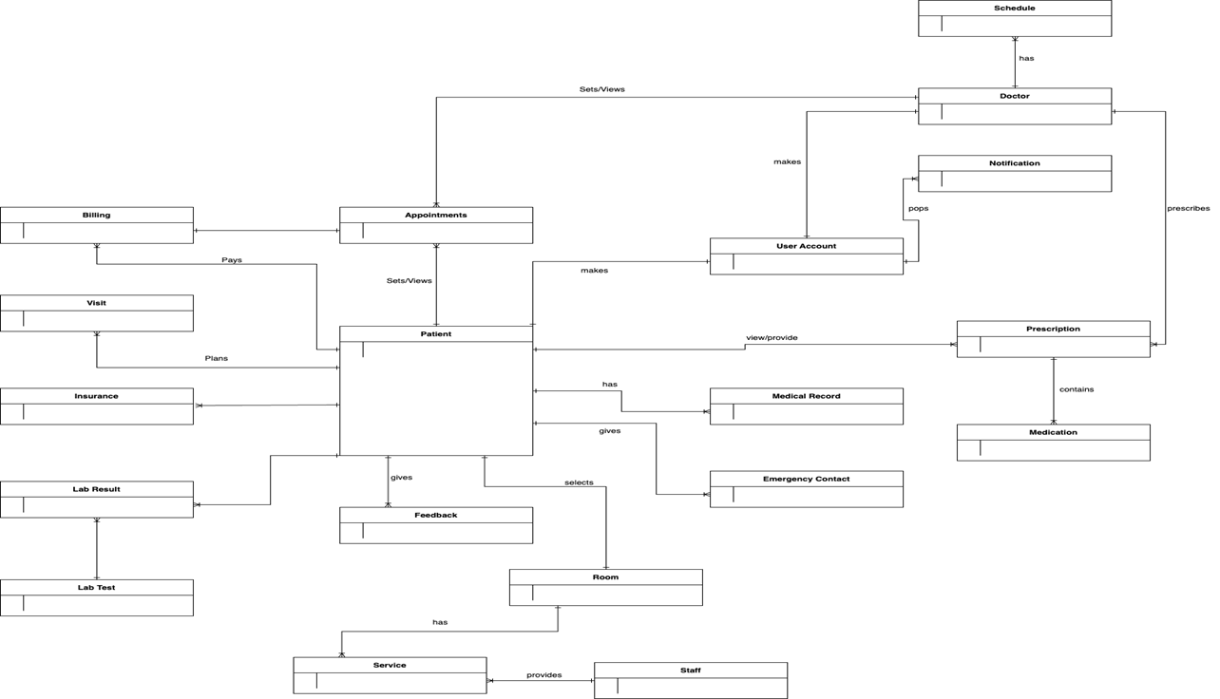
CONCEPTUAL MODELLING

Slide 7
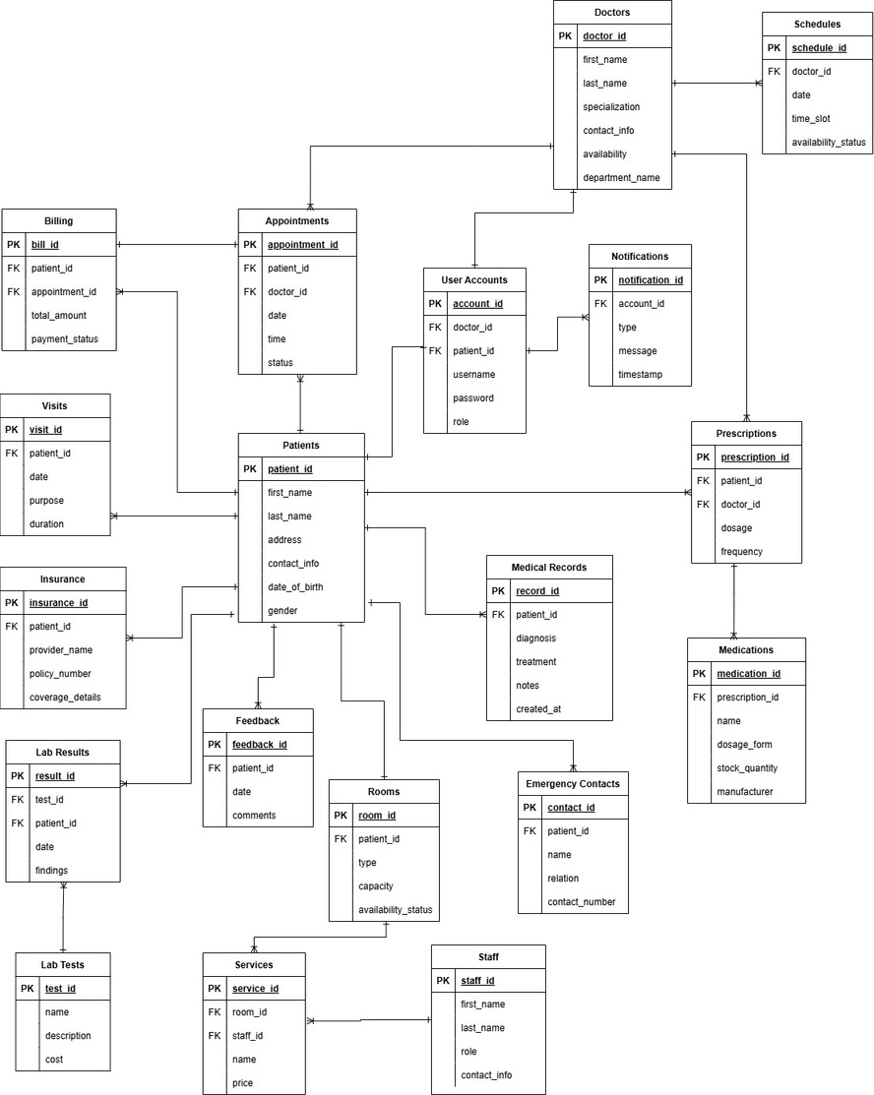
LOGICAL MODELLING

Slide 8
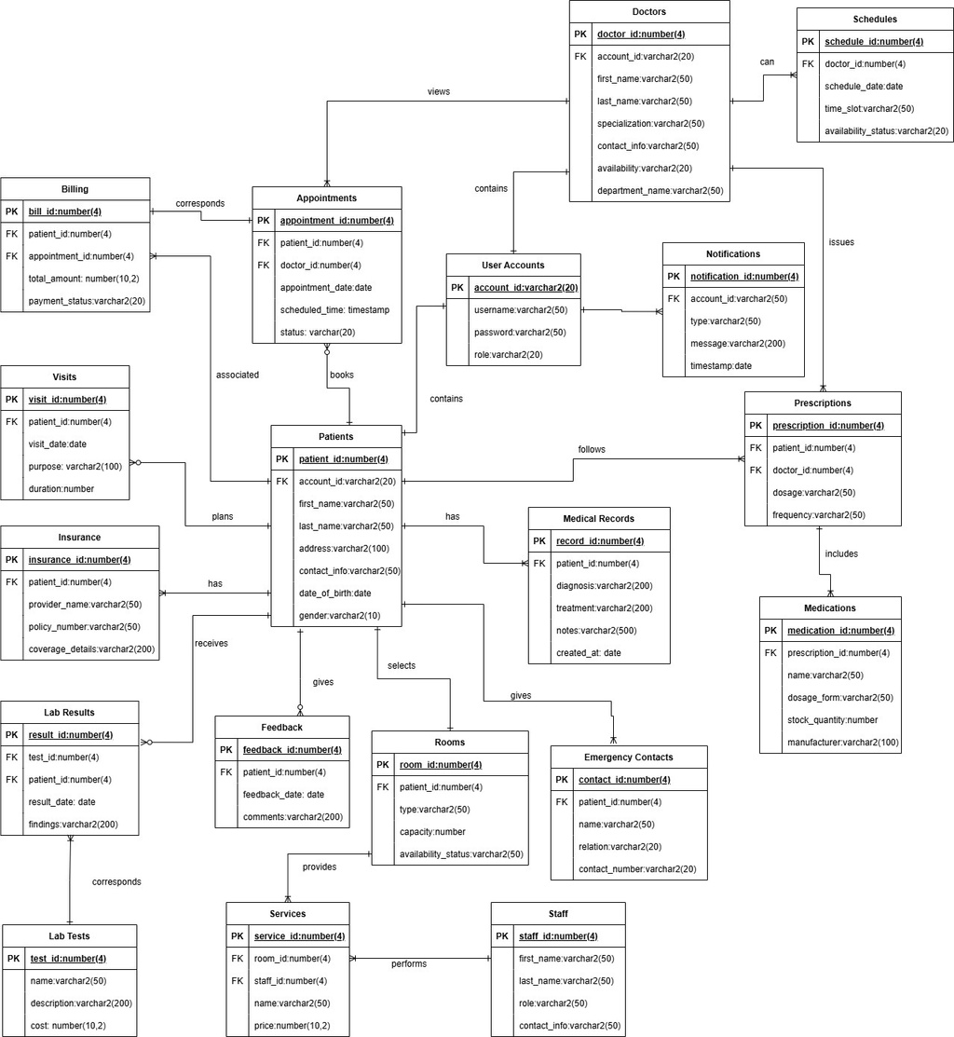
PHYSICAL DATABASE DESIGN

Slide 9
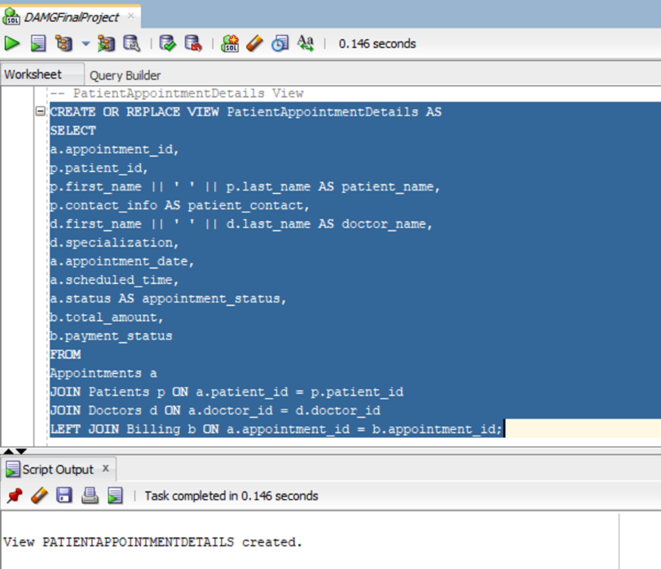
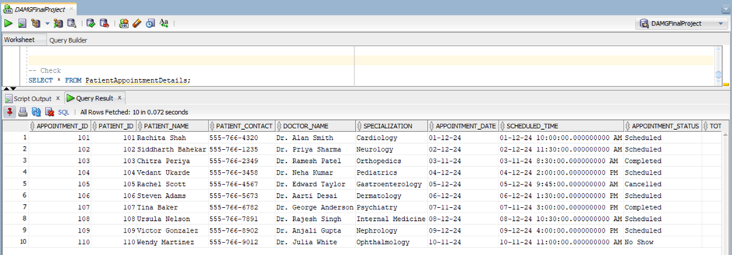
QUERIES - VIEW
• PatientAppointmentDetails View

Slide 10
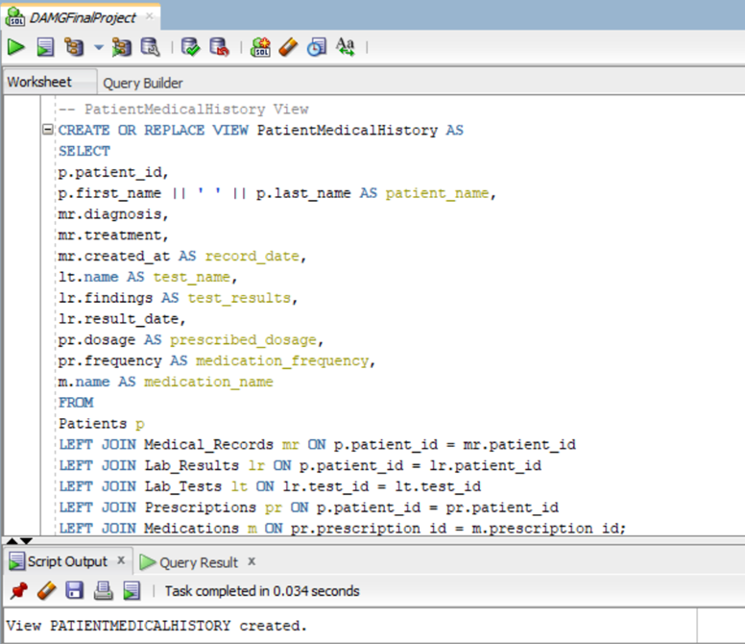
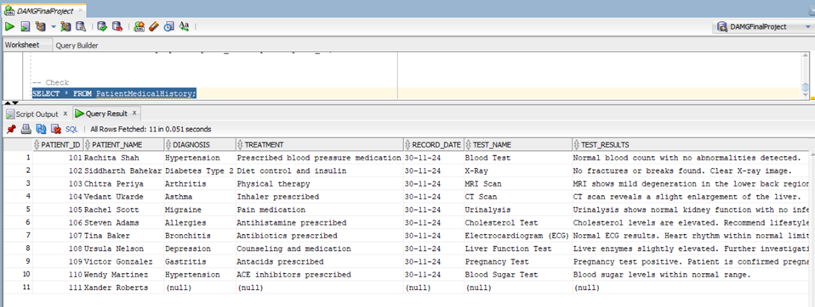
QUERIES - VIEW
• PatientMedicalHistory View

Slide 11
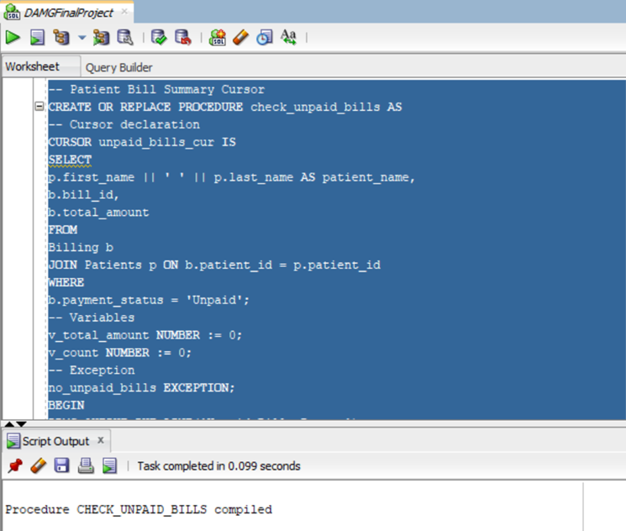
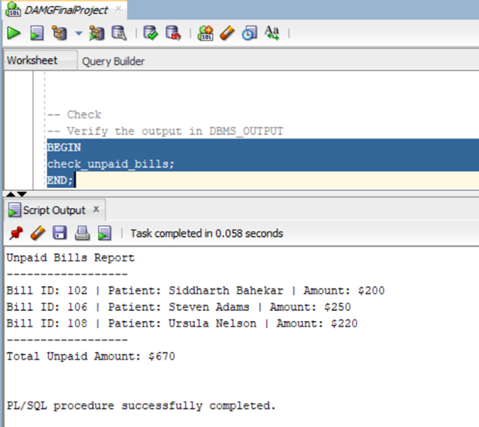
QUERIES - CURSOR
• Patient Bill Summary Cursor

Slide 12
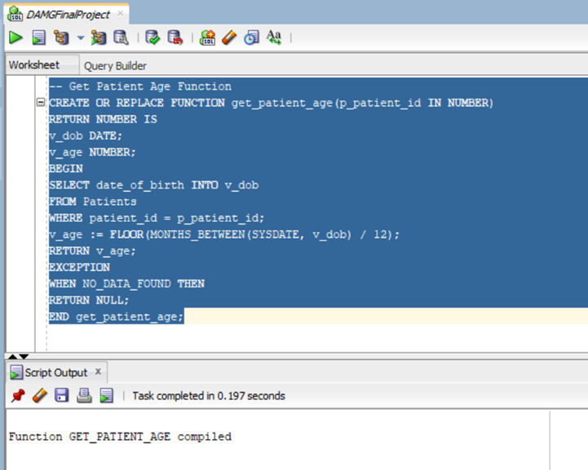
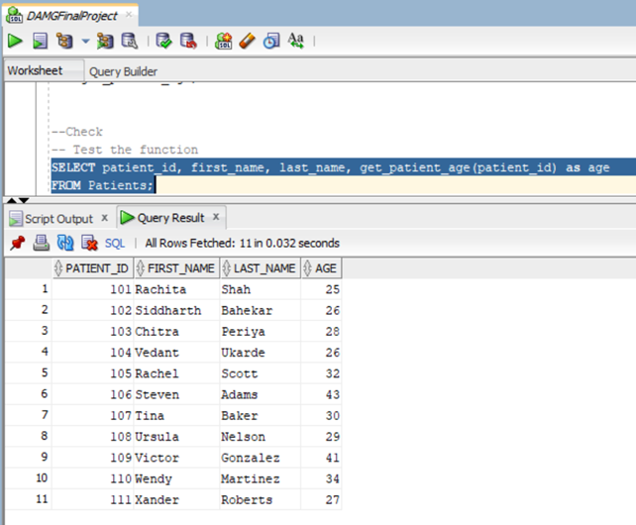
QUERIES - FUNCTION
• Get Patient Age Function

Slide 13
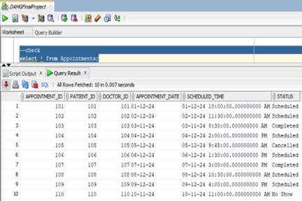
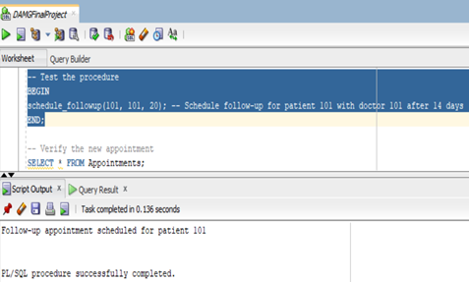
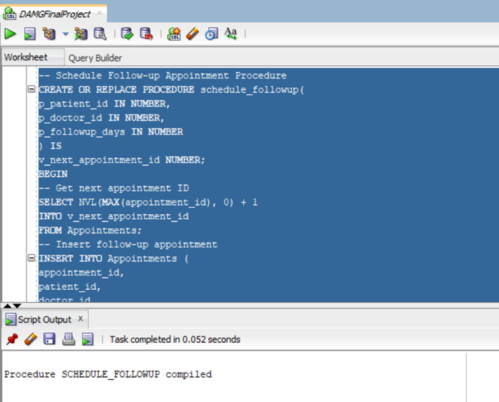
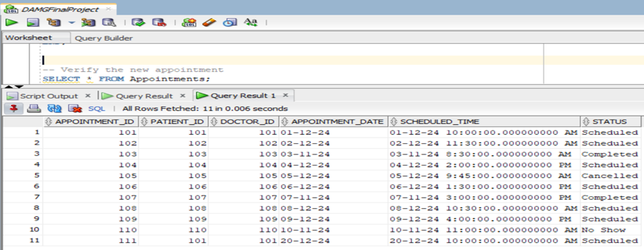
QUERIES - PROCEDURES
• Schedule Follow-up Appointment Procedure

Slide 14
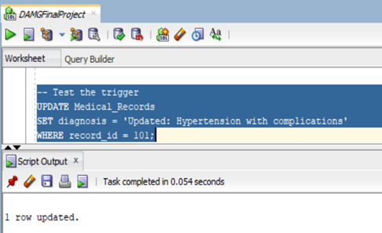
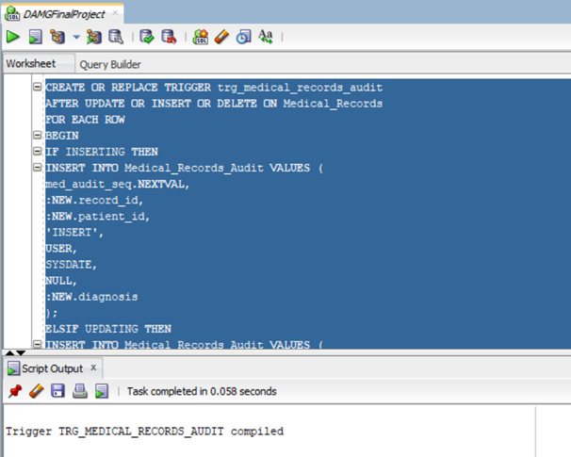
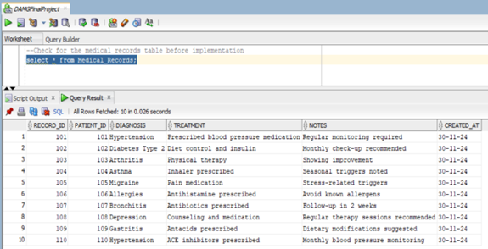
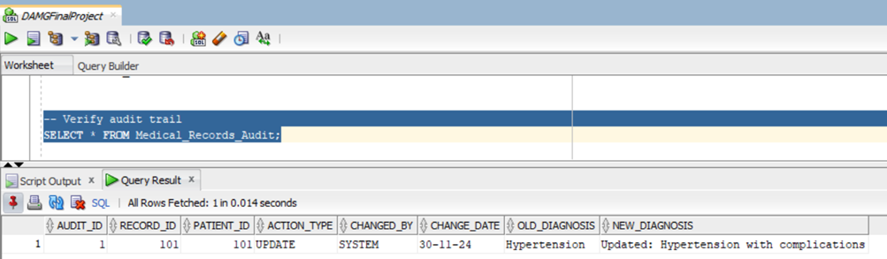
QUERIES - TRIGGERS
• Medical Record Audit Trigger

Slide 15
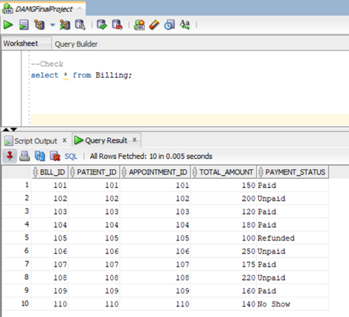
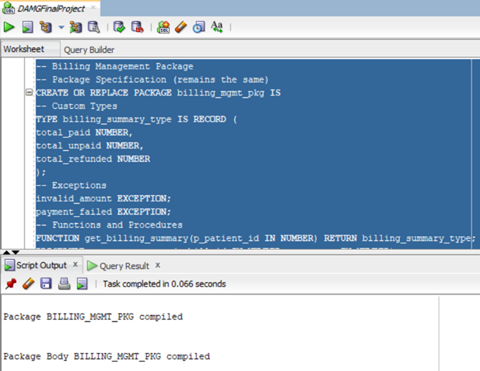
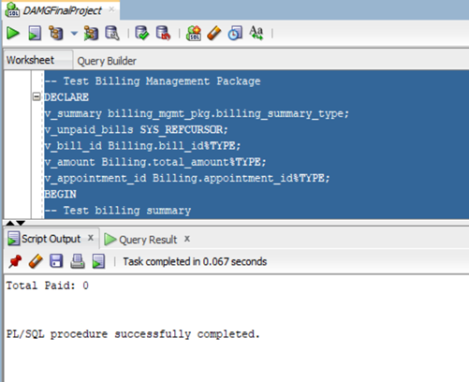
QUERIES - PACKAGES
• Billing Management Package

Slide 16
BUSINESS RULES
Patient registration requires unique account credentials and complete demographic information
Appointments can only have four status types: Scheduled, Completed, Cancelled, or No Show
Room allocation follows strict capacity rules with status tracking (Available, Occupied, Maintenance)
Billing status must follow a defined workflow: Paid, Unpaid, Refunded, or No Show
Medical records can only be created for registered patients with valid appointments
Lab results must be linked to specific tests and patients with proper documentation
Prescriptions require both patient and doctor validation before creation
Emergency contacts are mandatory for all registered patients
Notifications are automatically generated for appointment status changes

Slide 17
APPLICATIONS
Patient Management System
Appointment Scheduling System
Medical Records Management
Billing and Payment Processing
Laboratory Results Management
Room Management System
Staff Management System
Notification System
Insurance Management System

Slide 18
CHALLENGES
Data Volume Management: Handling large volumes of patient records, medical histories, and test results could strain database performance
System Integration: Connecting with existing healthcare systems, lab equipment, and insurance platforms
User Training: Training medical staff to effectively use the system
System Maintenance: Regular updates and maintenance without disrupting healthcare services
Billing Complexity: Managing different payment methods and insurance claims

Slide 19
SUMMARY
Modernize clinic operations with an advanced Healthcare Management System
Address billing, appointment, medical record and data challenges to boost efficiency and handle healthcare workflows
Encompasses requirement gathering, database design, implementation, testing, and maintenance phases
Utilize ERDs, RDBMS, PL/SQL and ETL processes for reliability and scalability
Revolutionize healthcare workflows, enhance patient management, and empower stakeholders with actionable insights for sustained success in the time sensitive, patient healthcare industry

Slide 20
Thank You!

